Slide 1
Employee Data Analysis using Excel
STUDENT NAME: RISHA PRASHANTHI R S
REGISTER NO: DB34D8226DEA00AAB0849DD3B27D646B, 312208756
DEPARTMENT: B.COM (GENERAL)
COLLEGE: MEENAKSHI COLLEGE FOR WOMEN

Slide 2
PROJECT TITLE
Employee Performance Analysis using Excel based on Gender, Department and Salary

Slide 3


AGENDA
Problem Statement
Project Overview
End Users
Our Solution and Proposition
Dataset Description
Modelling Approach
Results and Discussion
Conclusion
3/21/2024 Annual Review

Slide 4

PROBLEM STATEMENT
The purpose of this analysis is to leverage Excel to systematically evaluate the company’s employee data with a focus on gender distribution, departmental composition, and salary metrics. This will provide a clear picture of how employees are distributed across various departments, how salaries vary by gender and department, and where potential issues or imbalances might exist. This problem statement is designed to guide the analysis process and ensure comprehensive coverage of the key areas related to gender, department, and salary.

Slide 5

PROJECT OVERVIEW
Analyzing employee data provides valuable insights into organizational structure, gender representation, and compensation fairness. This analysis can help identify trends, disparities, and areas for improvement. Understanding the dynamics of workforce distribution and compensation is crucial for organizations aiming to foster an equitable and efficient work environment.

Slide 6

WHO ARE THE END USERS?
● HUMAN RESOURCE DEPARTMENTS
● EMPLOYEES
● BUSINESS ANALYSTS
● EXECUTIVE LEADERSHIP
● TEAM LEADERS AND SUPERVISORS
● FINANCIAL ANALYSTS
● RECRUITERS

Slide 7

OUR SOLUTION AND ITS VALUE PROPOSITION
PIVOT TABLE – SUMMARY
OF EMPLOYEE PERFORMANCE
BAR DIAGRAM – FINAL
REPORT

Slide 8
Dataset Description
EMPLOYEE DATA SET – NAN MUDHALVAN PORATAL (EDUNET-KAGGLE)
9 FEATURES IN EXCEL:
EMPLOYEE ID – ALPHANUMERIC (TEXT)
NAME – ALPHABETICAL (TEXT)
GENDER – ALPHABETICAL (TEXT)
DEPARTMENT – ALPHABETICAL (TEXT)
SALARY - NUMERICAL
START DATE – ALPHANUMERIC (TEXT)
FTE - NUMERICAL
EMPLOYEE TYPE – ALPHABETICAL (TEXT)
EMPLOYEE LOCATION – ALPHABETICAL (TEXT)
3 FEATURES USED:
DEPARTMENT – ALPHABETICAL (TEXT)
SALARY - NUMERICAL
GENDER – ALPHABETICAL (TEXT)

Slide 9

THE "WOW" IN OUR SOLUTION
Employee Performance Analysis based on Gender, Department, and Salary lies in its comprehensive, data-driven approach and the tools available to facilitate detailed insights and actionable recommendations.
Provides insights into how gender, department, and salary impact employee performance, enabling informed decision-making and management strategies.
3/21/2024 Annual Review
9

Slide 10
MODELLING
STEP-1
DOWNLOAD THE EMPLOYEE DATASET AND OPEN THE
EMPLOYEE DATASET IN EXCEL.
STEP-2
SELECT THE ENTIRE DATA AND CLICK ON INSERT
AND CLICK ON PIVOT TABLE TO CREATE PIVOT TABLE.
STEP-3
DRAG THE NEEDED DATA AND CREATE A PIVOT
TABLE.
10

Slide 11
STEP-4
FILTER TO NARROW DOWN DATA TO SPECIFIC DEPARTMENTS, SALARY, OR GENDER.
STEP-5
SELECT THE PIVOT TABLE AND CLICK ON
INSERT TO CREATE A CHART
STEP-6
NOW CLICK ON THE CHART THAT YOU WANT.
STEP-7
THE WANTED CHART IS CREATED.

Slide 12
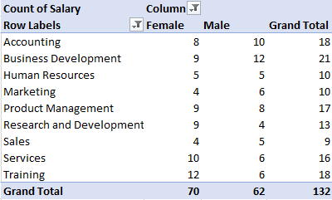
RESULTS
1.TABLE
12

Slide 13
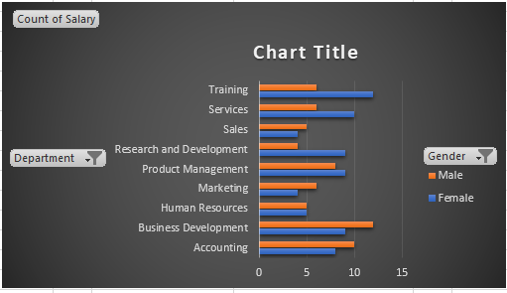
2. BAR DIAGRAM

Slide 14
conclusion
The Employee Performance Analysis based on gender, department, and salary, provides a comprehensive view of how these factors impact employee performance within an organization. By utilizing Excel’s powerful data analysis tools, the analysis reveals significant trends and disparities, such as gender-based performance differences, variations in departmental effectiveness, and the relationship between salary and performance. These insights are crucial for addressing potential biases, optimizing resource allocation, and ensuring that compensation aligns with employee contributions. The findings offer a solid foundation for implementing strategic improvements, such as enhancing equity in performance evaluations, supporting underperforming departments, and refining compensation practices. Overall, this analysis not only highlights areas for immediate action but also supports a data-driven approach to fostering a more equitable and effective workplace.

